Slide 1
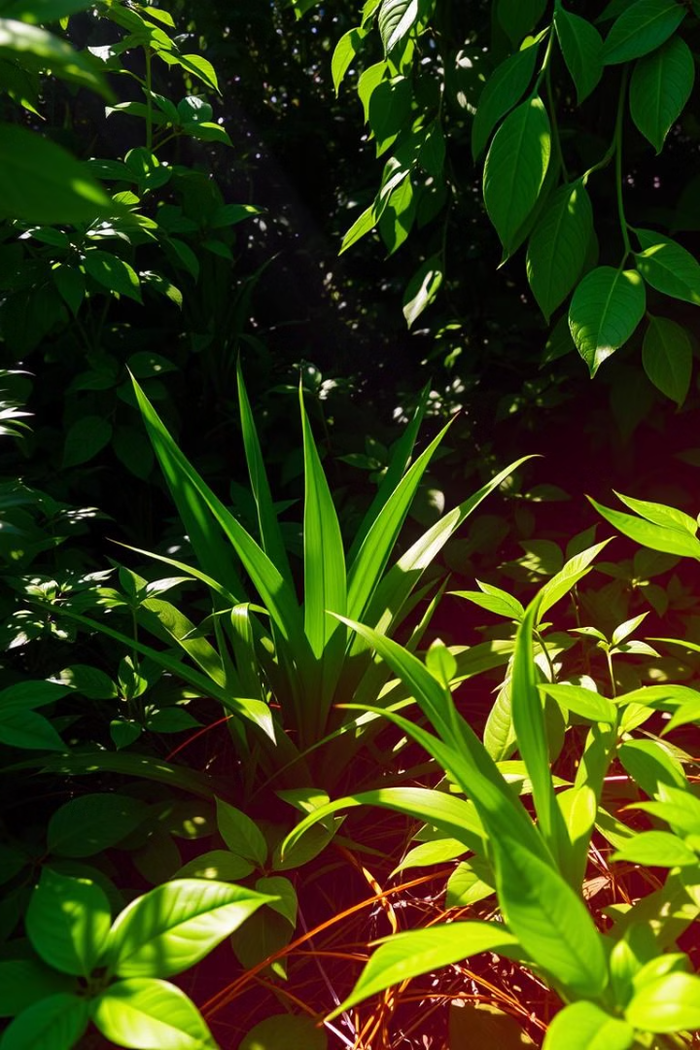
Plant Disease Detection Using Custom CNN and Streamlit
Detecting and diagnosing plant diseases is crucial for maintaining healthy crops and gardens. By leveraging the power of deep learning, we have developed a comprehensive solution that can accurately identify a wide range of plant diseases. This presentation will guide you through our innovative approach, from the custom Convolutional Neural Network (CNN) architecture to the interactive Streamlit-based web application.

Slide 2
Objectives and Motivations
Objectives
Motivations
Our primary objectives are to create a robust and accurate plant disease detection system that can be easily accessible to farmers, gardeners, and agricultural professionals. We aim to empower them with a tool that can swiftly and reliably diagnose plant health issues, enabling timely interventions and improving overall crop yields and plant vitality.
The motivation behind this project stems from the significant challenges faced in traditional visual plant disease diagnosis, including the subjectivity of human assessments, the need for specialized expertise, and the time-consuming nature of the process. By leveraging advanced deep learning techniques, we strive to provide a scalable, automated, and user-friendly solution to address these pain points.

Slide 3

Challenges in Visual Plant Disease Diagnosis
1
Complexity of Symptoms
2
Environmental Factors
Environmental conditions, such as weather, soil quality, and pests, can significantly influence the manifestation of plant diseases, further complicating the diagnostic process.
Plant diseases can exhibit a wide range of subtle and complex symptoms, making it challenging for even experienced professionals to accurately diagnose the underlying issues.
3
Scalability Limitations
Traditional visual inspection methods are time-consuming and labor-intensive, making it difficult to scale plant disease detection and response at a larger scale.

Slide 4





CNN Architecture for Disease Classification
Input Layer
1
High-resolution plant images
Convolutional Layers
2
Extraction of visual features
Pooling Layers
3
Downsampling and spatial invariance
Fully Connected Layers
4
Classification of plant disease
Output Layer
5
Predicted disease class

Slide 5
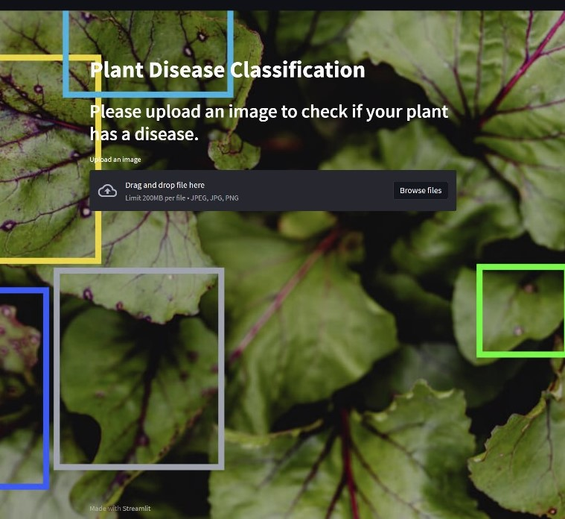
Streamlit: Building Interactive Web App
1
Upload
Users can easily upload plant images for disease detection.
2
Inference
The custom CNN model processes the uploaded image and provides a disease diagnosis.
3
Visualization
The web app displays the classified disease, along with relevant information.

Slide 6

Experimental Results and Performance Metrics
94.52%
Recall
Our model achieved a recall of 94.52%, indicating it correctly identified 94.52% of the actual positive cases.
94.78%
Accuracy
The custom CNN model achieved an impressive accuracy of 95% on a comprehensive test dataset, showcasing its robust performance in identifying a wide range of plant diseases.
95.27%
Precision
Precision measures the proportion of correctly predicted positive cases out of all cases predicted as positive by the model which has reached 95.27% in our model.
0.3s
Inference Time
The plant disease detection process takes only 0.3 seconds on average, enabling real-time diagnosis and rapid response to emerging plant health issues.

Slide 7

Data Preprocessing for Plant Disease Detection
Image Preprocessing
Label Encoding
Train-Test Split
To prepare the image data for the CNN model, we implemented a comprehensive preprocessing pipeline. This includes resizing all images to a consistent size, normalizing pixel values, and applying data augmentation techniques to increase the diversity of the training data.
The plant disease labels were encoded as numeric values to be compatible with the output layer of the CNN model. We used one-hot encoding to represent the multi-class disease classifications.
The dataset was split into training and testing sets, ensuring that the model is evaluated on unseen data. This helps to assess the generalization capabilities of the CNN model.

Slide 8
Conclusions and Future Scope
Accurate Disease Detection
1
Our custom CNN model has demonstrated exceptional performance in accurately identifying a wide range of plant diseases, providing a reliable and scalable solution for agricultural professionals and enthusiasts.
Streamlined Diagnosis
2
The Streamlit-powered web application offers a user-friendly interface, enabling quick and easy disease diagnosis, empowering users to take prompt action and improve plant health.
Future Scope
In the future, we plan to expand the capabilities of our solution by integrating additional features, such as adding a raspberry pi camera that will process an image in real time .
3

Slide 9

Thank You

